Slide 1
VC Dimension

Slide 2
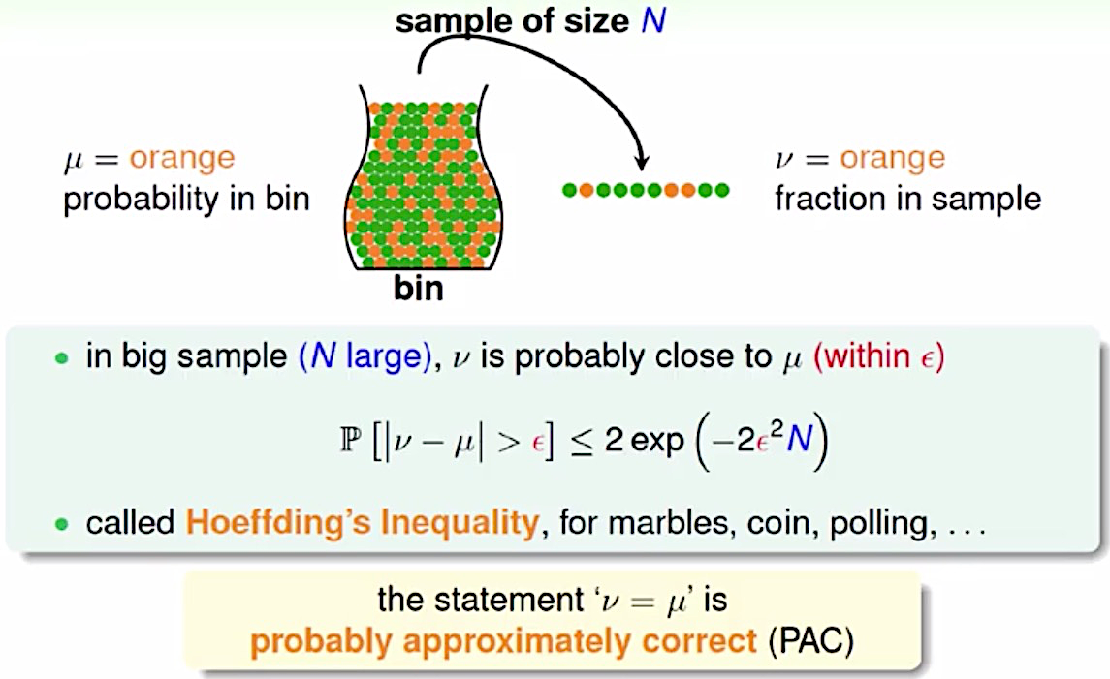
Hoeffding’s Inequality

Slide 3
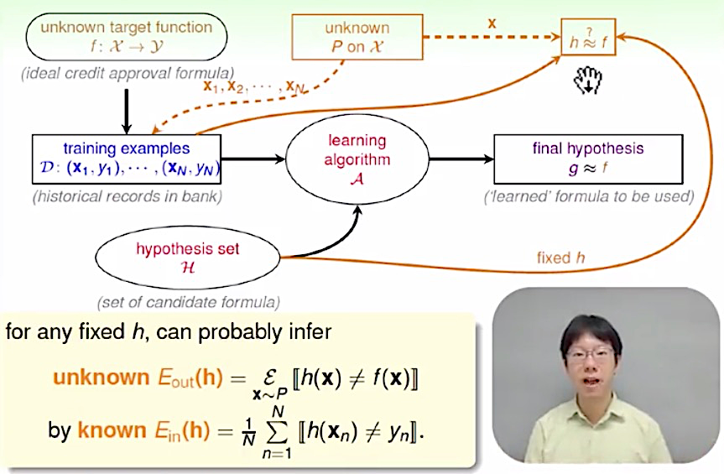
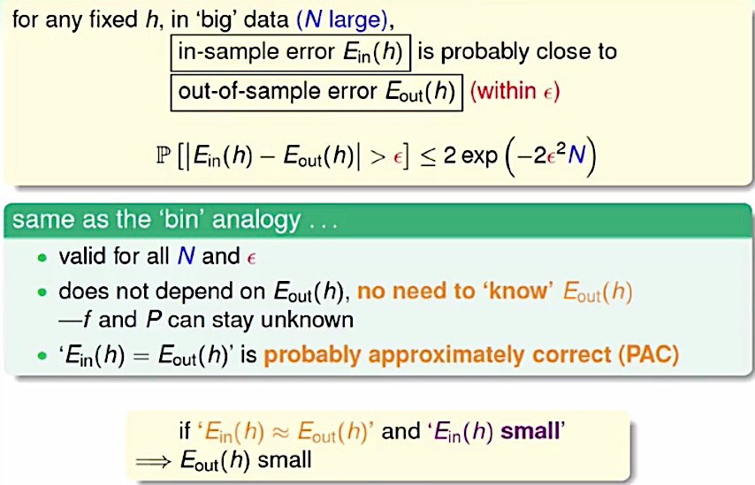
Hoeffding’s Inequality

Slide 4
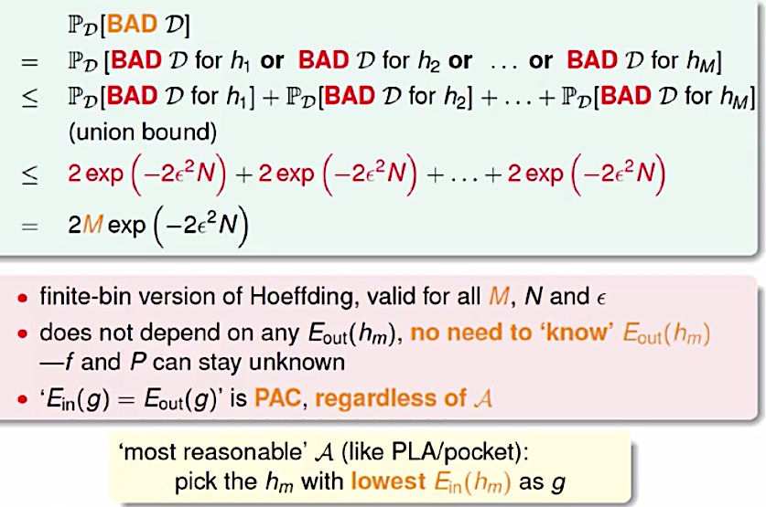
Bound of BAD Data

Slide 5
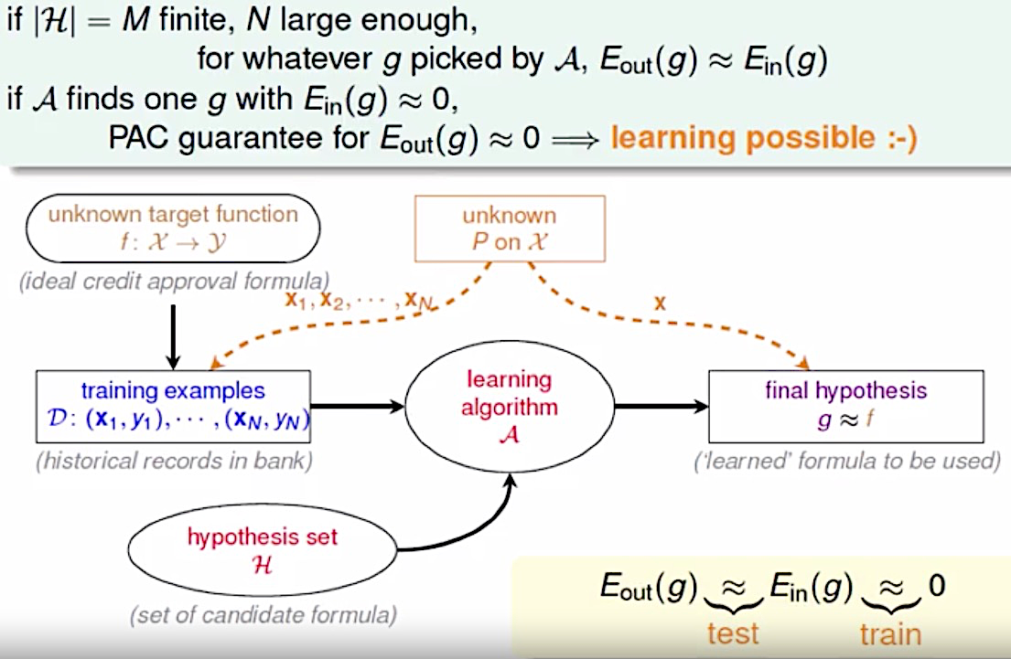
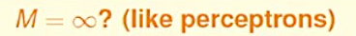
The ‘Statistical’ Learning Flow
The Estimation Error
The Approximation Error

Slide 6
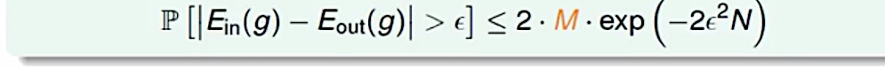
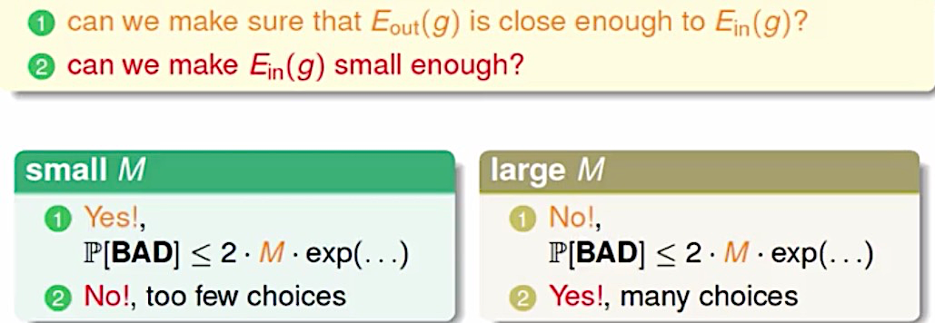
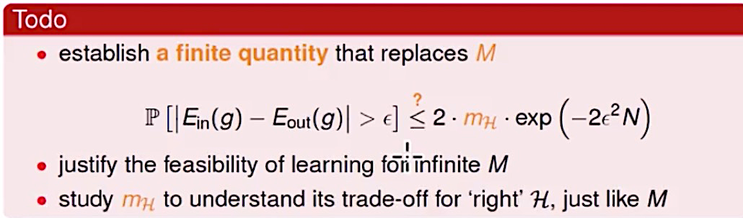
To do

Slide 7
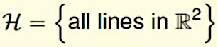
Effective Number of Lines
How many lines are there?
How many kinds of lines if viewed from
-- One input vector x1?
-- Two inputs x1, x2?
-- Three inputs x1, x2, x3?
-- Four inputs x1, x2, x3, x4?
-- Five inputs x1, x2, x3, x4, x5?

Slide 8
Effective Number of Hypotheses
Dichotomies
Growth function
Shatter
Break point
Bounding function
VC dimension

Slide 9
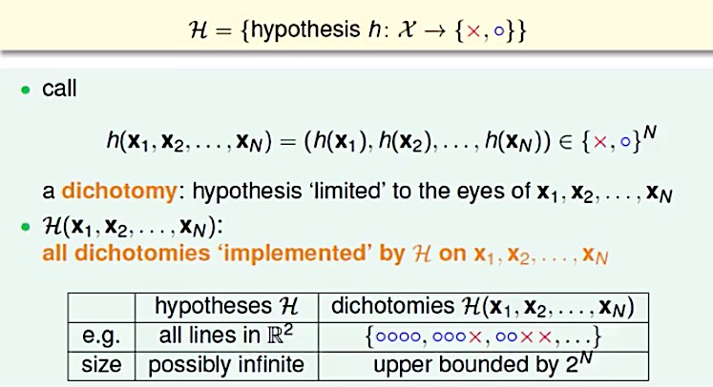
Dichotomies

Slide 10
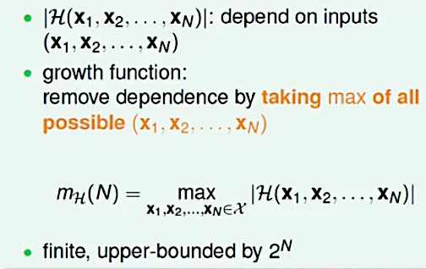
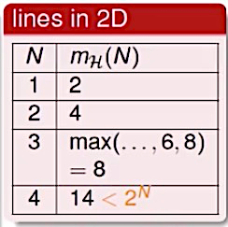
Growth Function

Slide 11
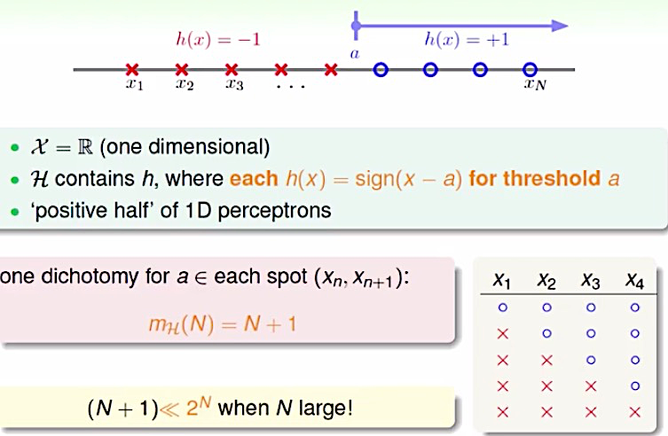
Growth Function for Positive Rays

Slide 12
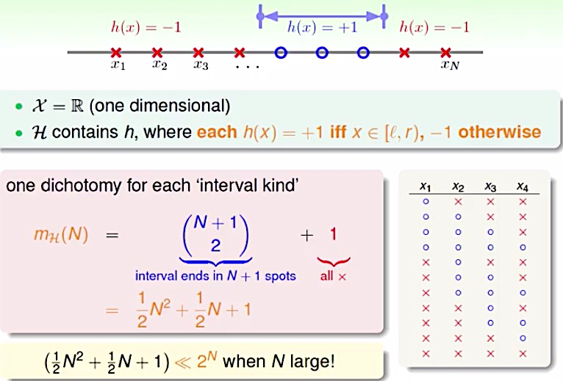
Growth Function for Positive Intervals

Slide 13
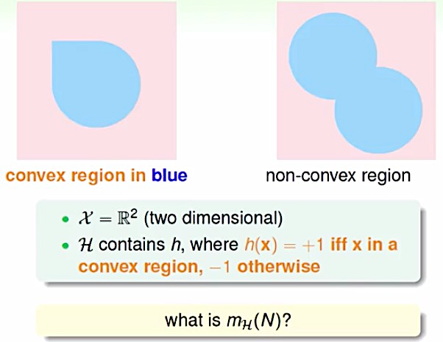
Growth Function for Convex Sets

Slide 14
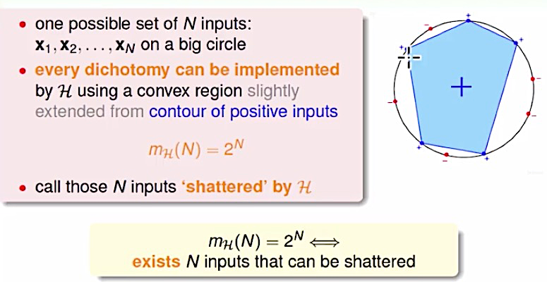
Growth Function for Convex Sets

Slide 15
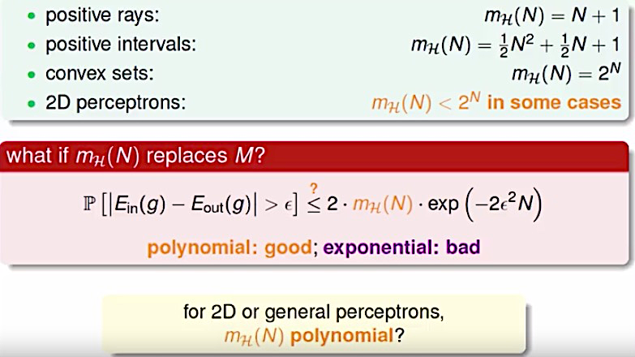
The Four Growth Functions

Slide 16
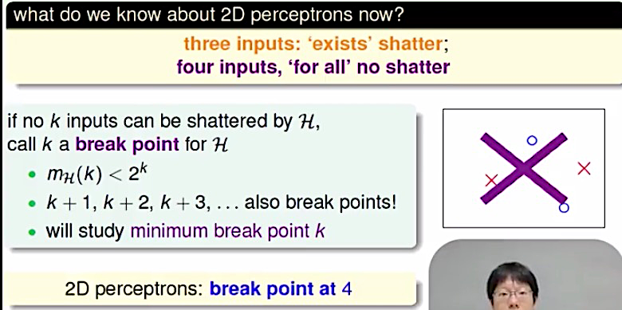
Break Point

Slide 17
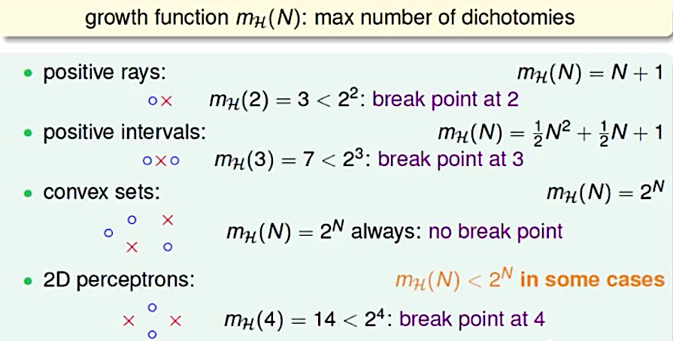
The Four Break Points

Slide 18
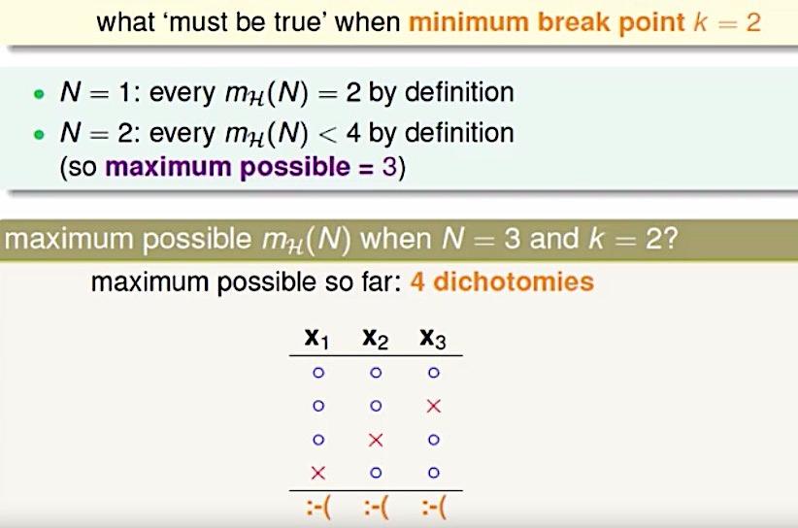
Restriction of Break Point

Slide 19
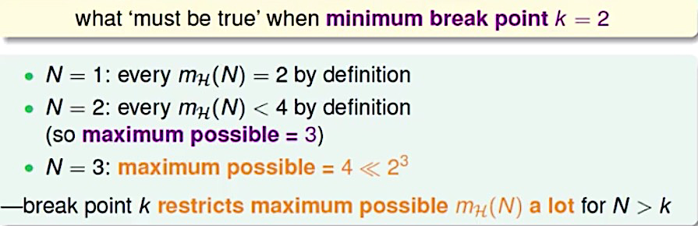
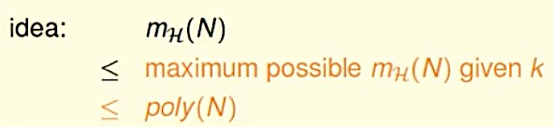
Restriction of Break Point

Slide 20
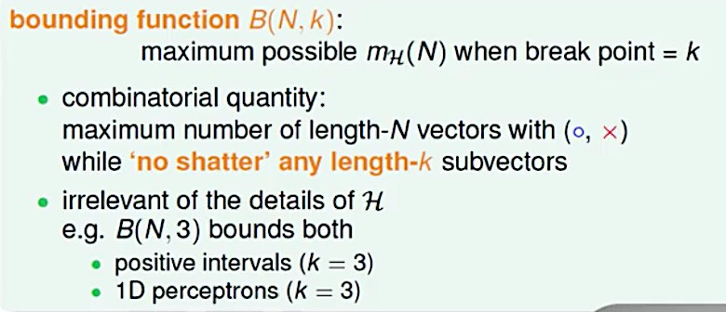
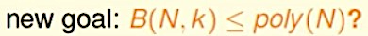
Bounding Function

Slide 21
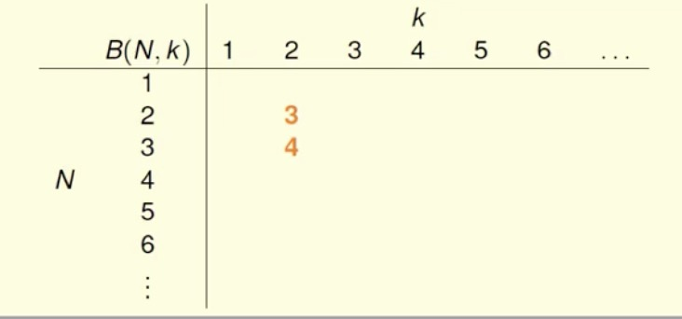
Table of Bounding Function

Slide 22
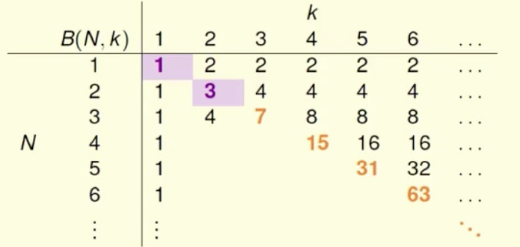
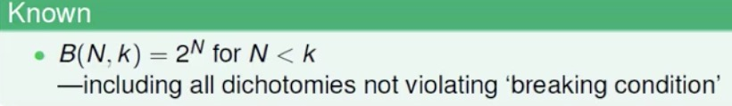
Table of Bounding Function

Slide 23
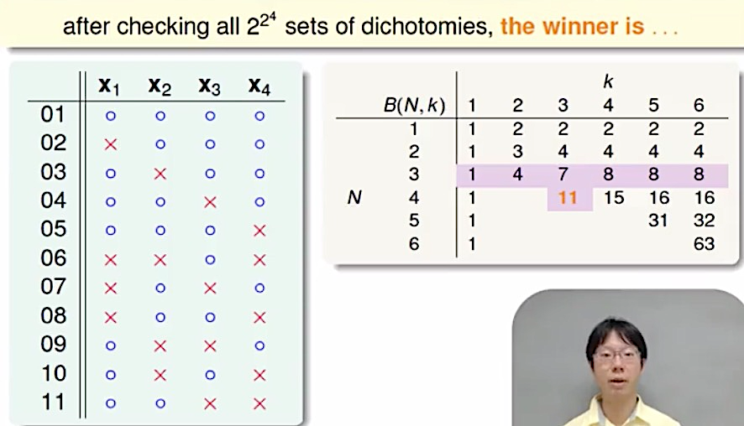
‘Achieving’ Dichotomies of B(4,3)

Slide 24
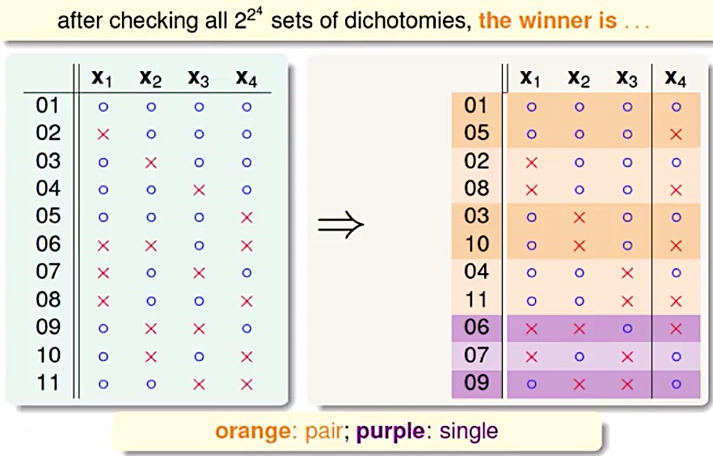
Reorganized Dichotomies of B(4,3)

Slide 25
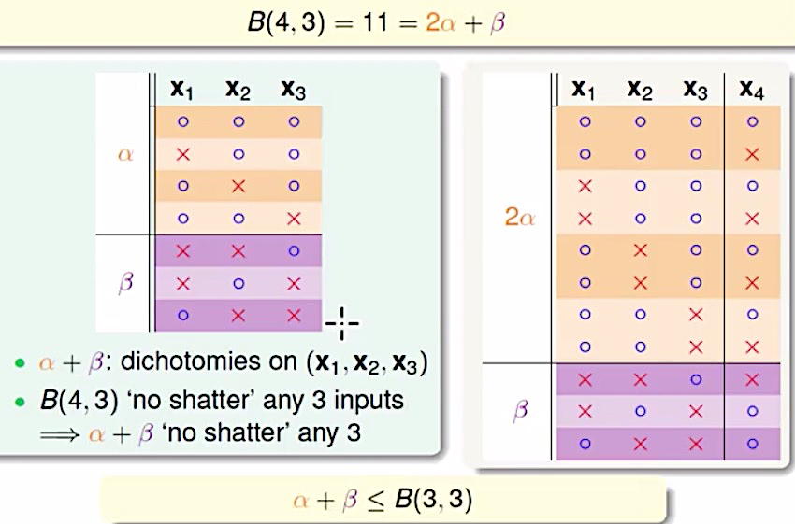
Estimating Part of B(4,3)

Slide 26
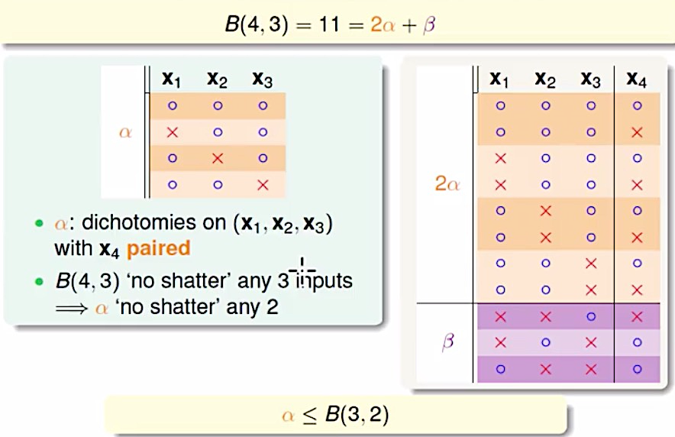
Estimating Part of B(4,3)

Slide 27
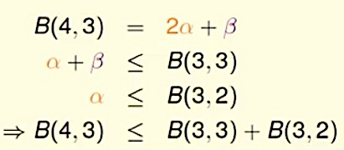
Putting It All Together

Slide 28
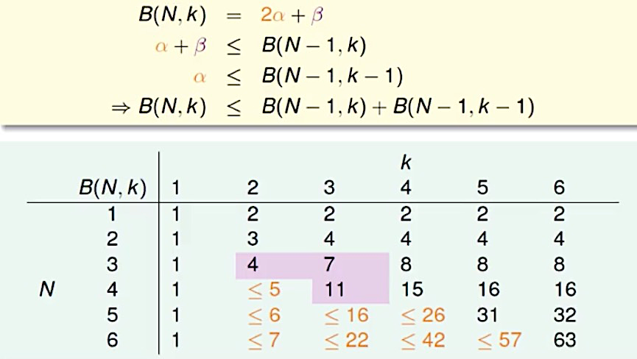
Putting It All Together
Now have upper bound of bounding function

Slide 29
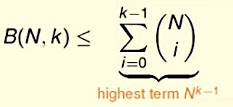
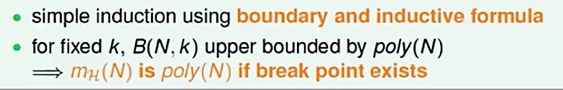
Bounding Function: The Theorem

Slide 30
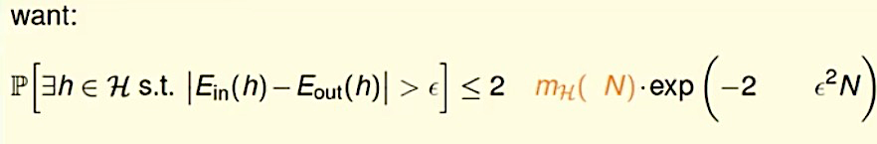
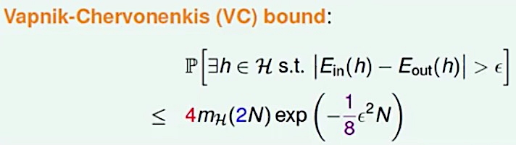
BAD Bound for General H
Actually, when N is large enough

Slide 31
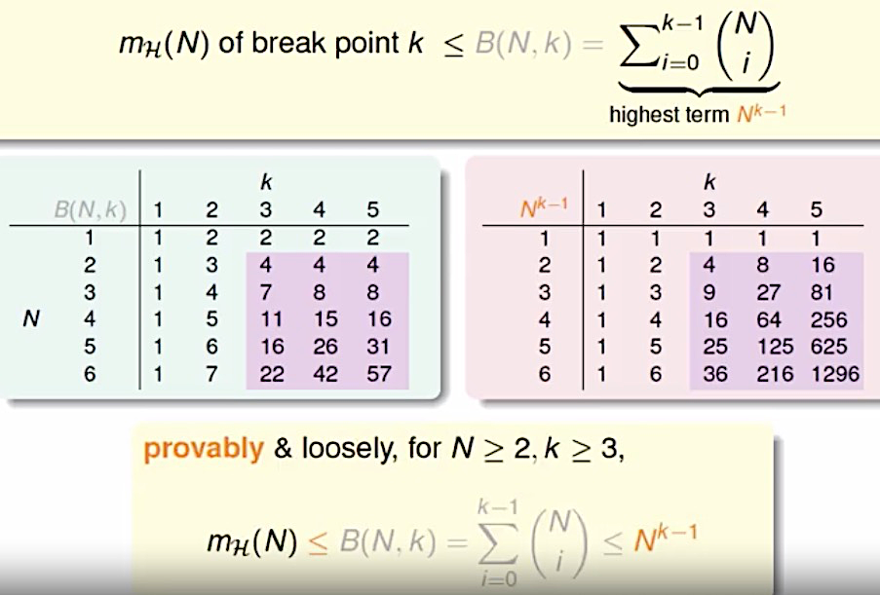
More on Growth Function

Slide 32
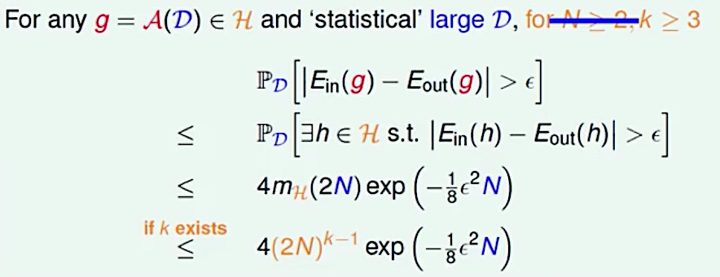
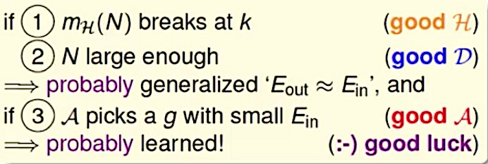
More on VC Bound

Slide 33
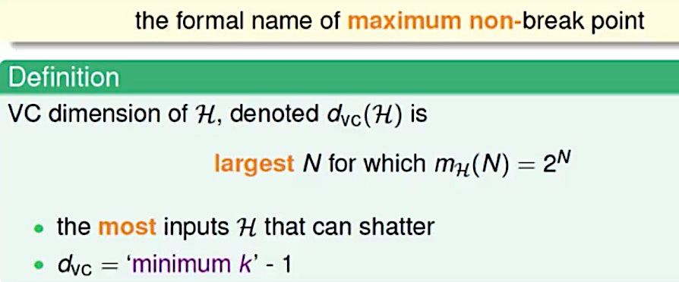
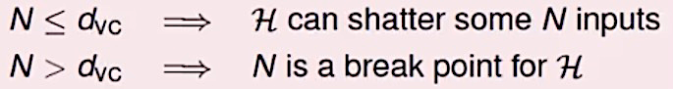
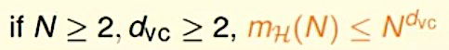
VC Dimension

Slide 34
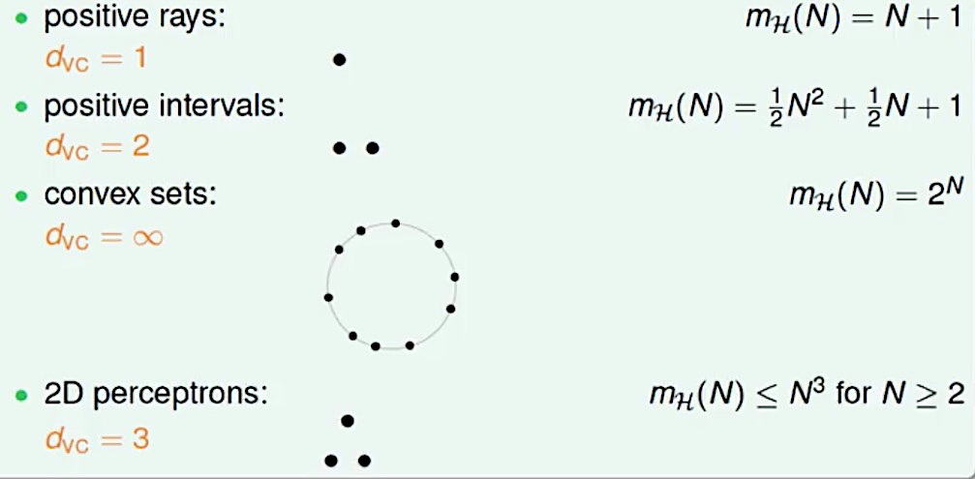
The Four VC Dimensions
Good: finite d_{vc}
Notes:
d

Slide 35
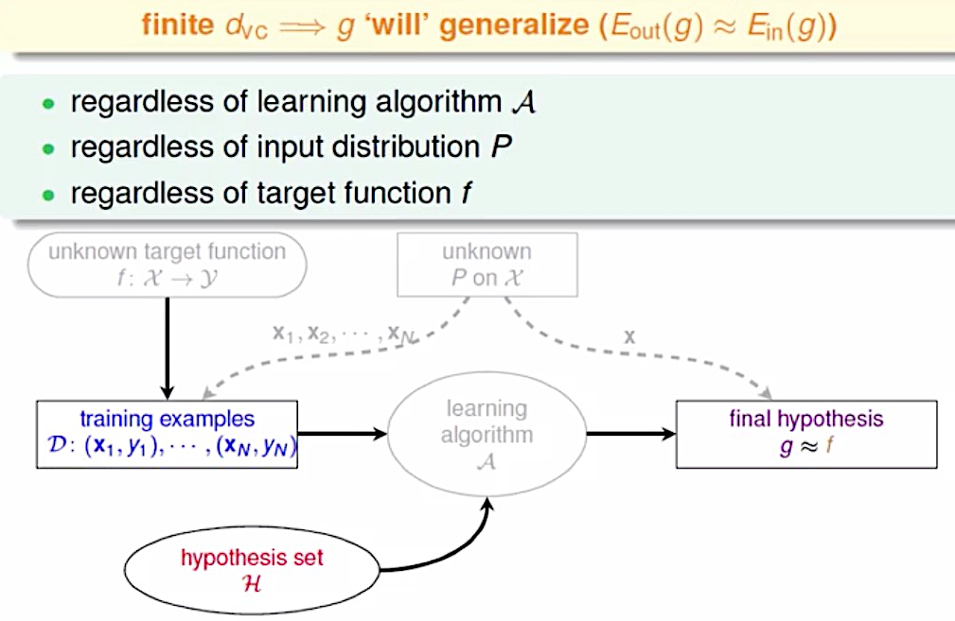
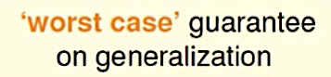
VC Dimension and Learning
Notes:
d

Slide 36
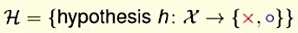
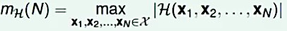
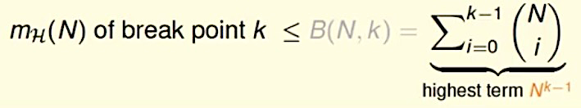

Effective Number of Hypotheses
Dichotomies
Growth function
Shatter
Break point
Bounding function
VC dimension (the most inputs H that can shatter)
$$d_{vc}=′minimum k^{′}−1$$

Slide 37

Degrees of Freedom
Notes:
d

Slide 38

Physical Intuition of VC Dimension
Notes:
d

Slide 39

M and dvc (The Bias-Complexity Tradeoff)
Notes:
d

Slide 40

VC Bound Rephrase: Penalty for Model Complexity

Slide 41



Interpreting VC Dimension

Slide 42

VC Bound Rephrase: Sample Complexity

Slide 43

Looseness of VC Bound
Philosophical message of VC bound important for improving ML
Notes:
d

